Slide 1
Measures of association
MWAI

Slide 2
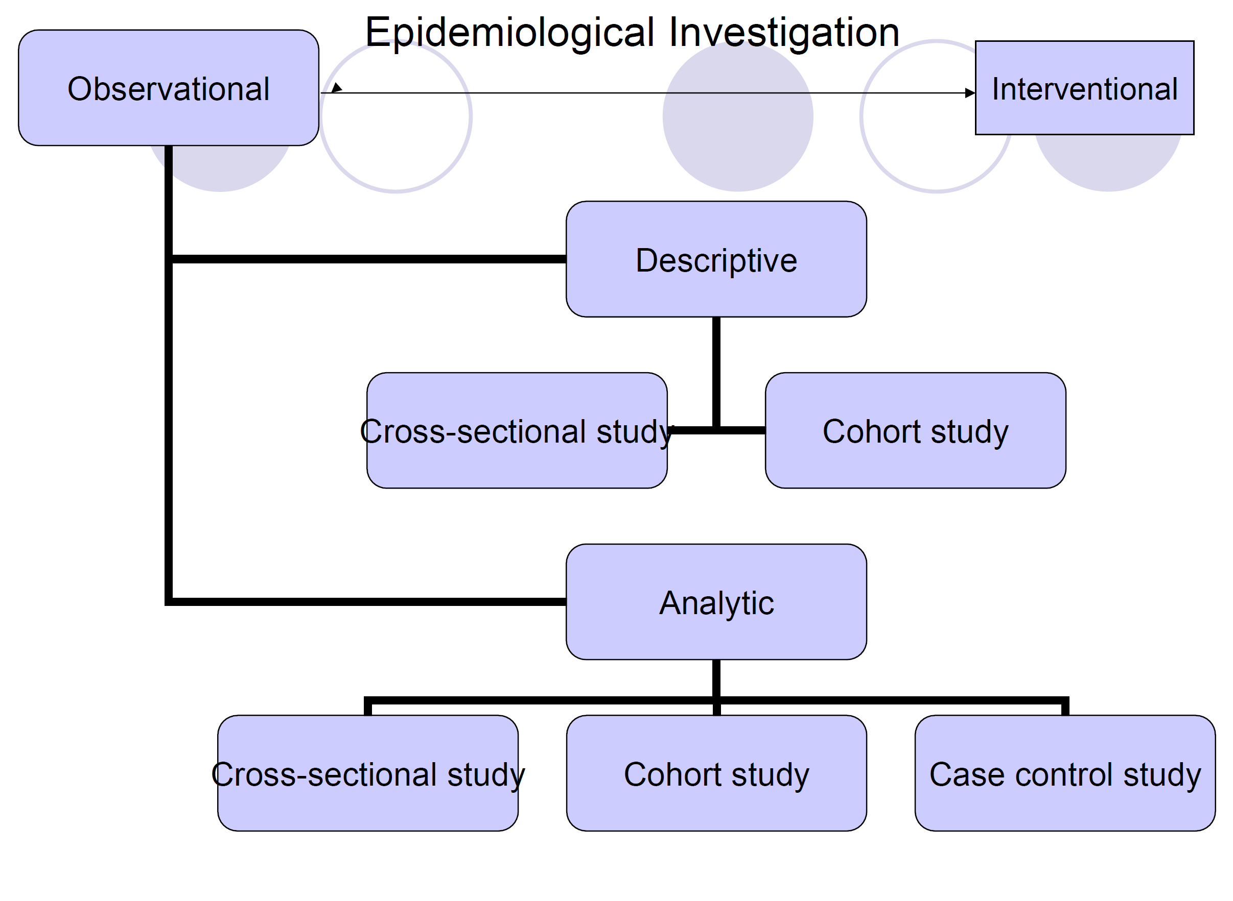

Slide 3
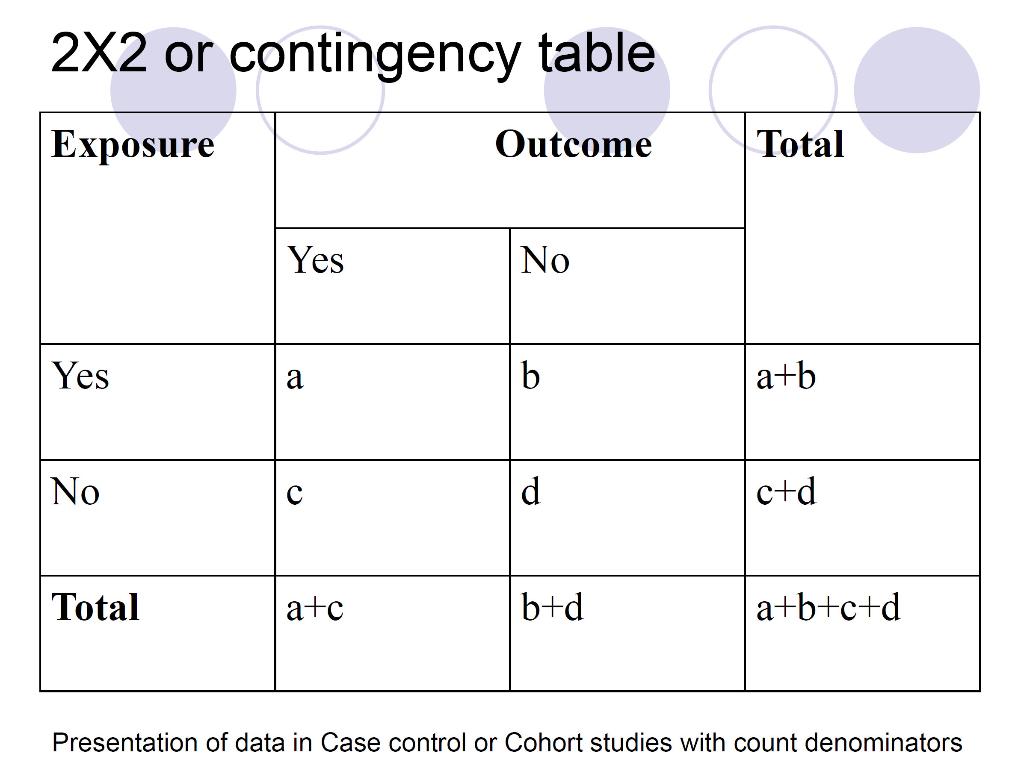

Slide 4
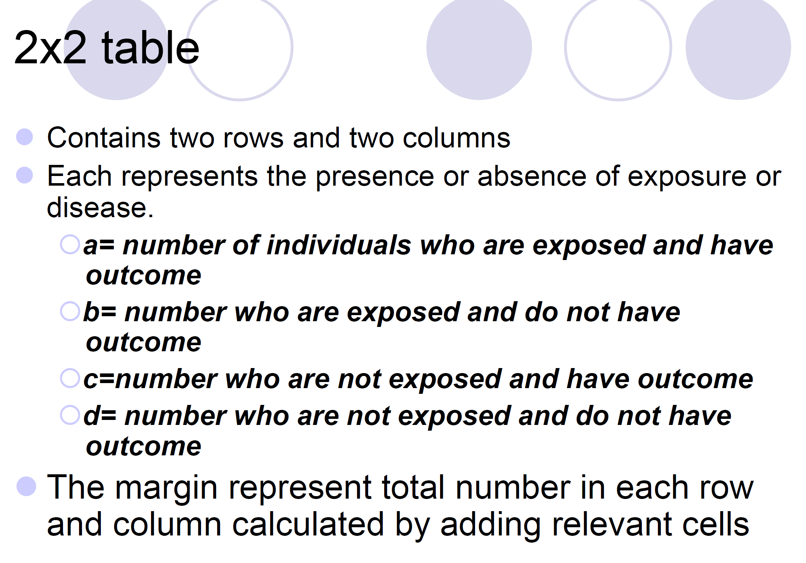

Slide 5
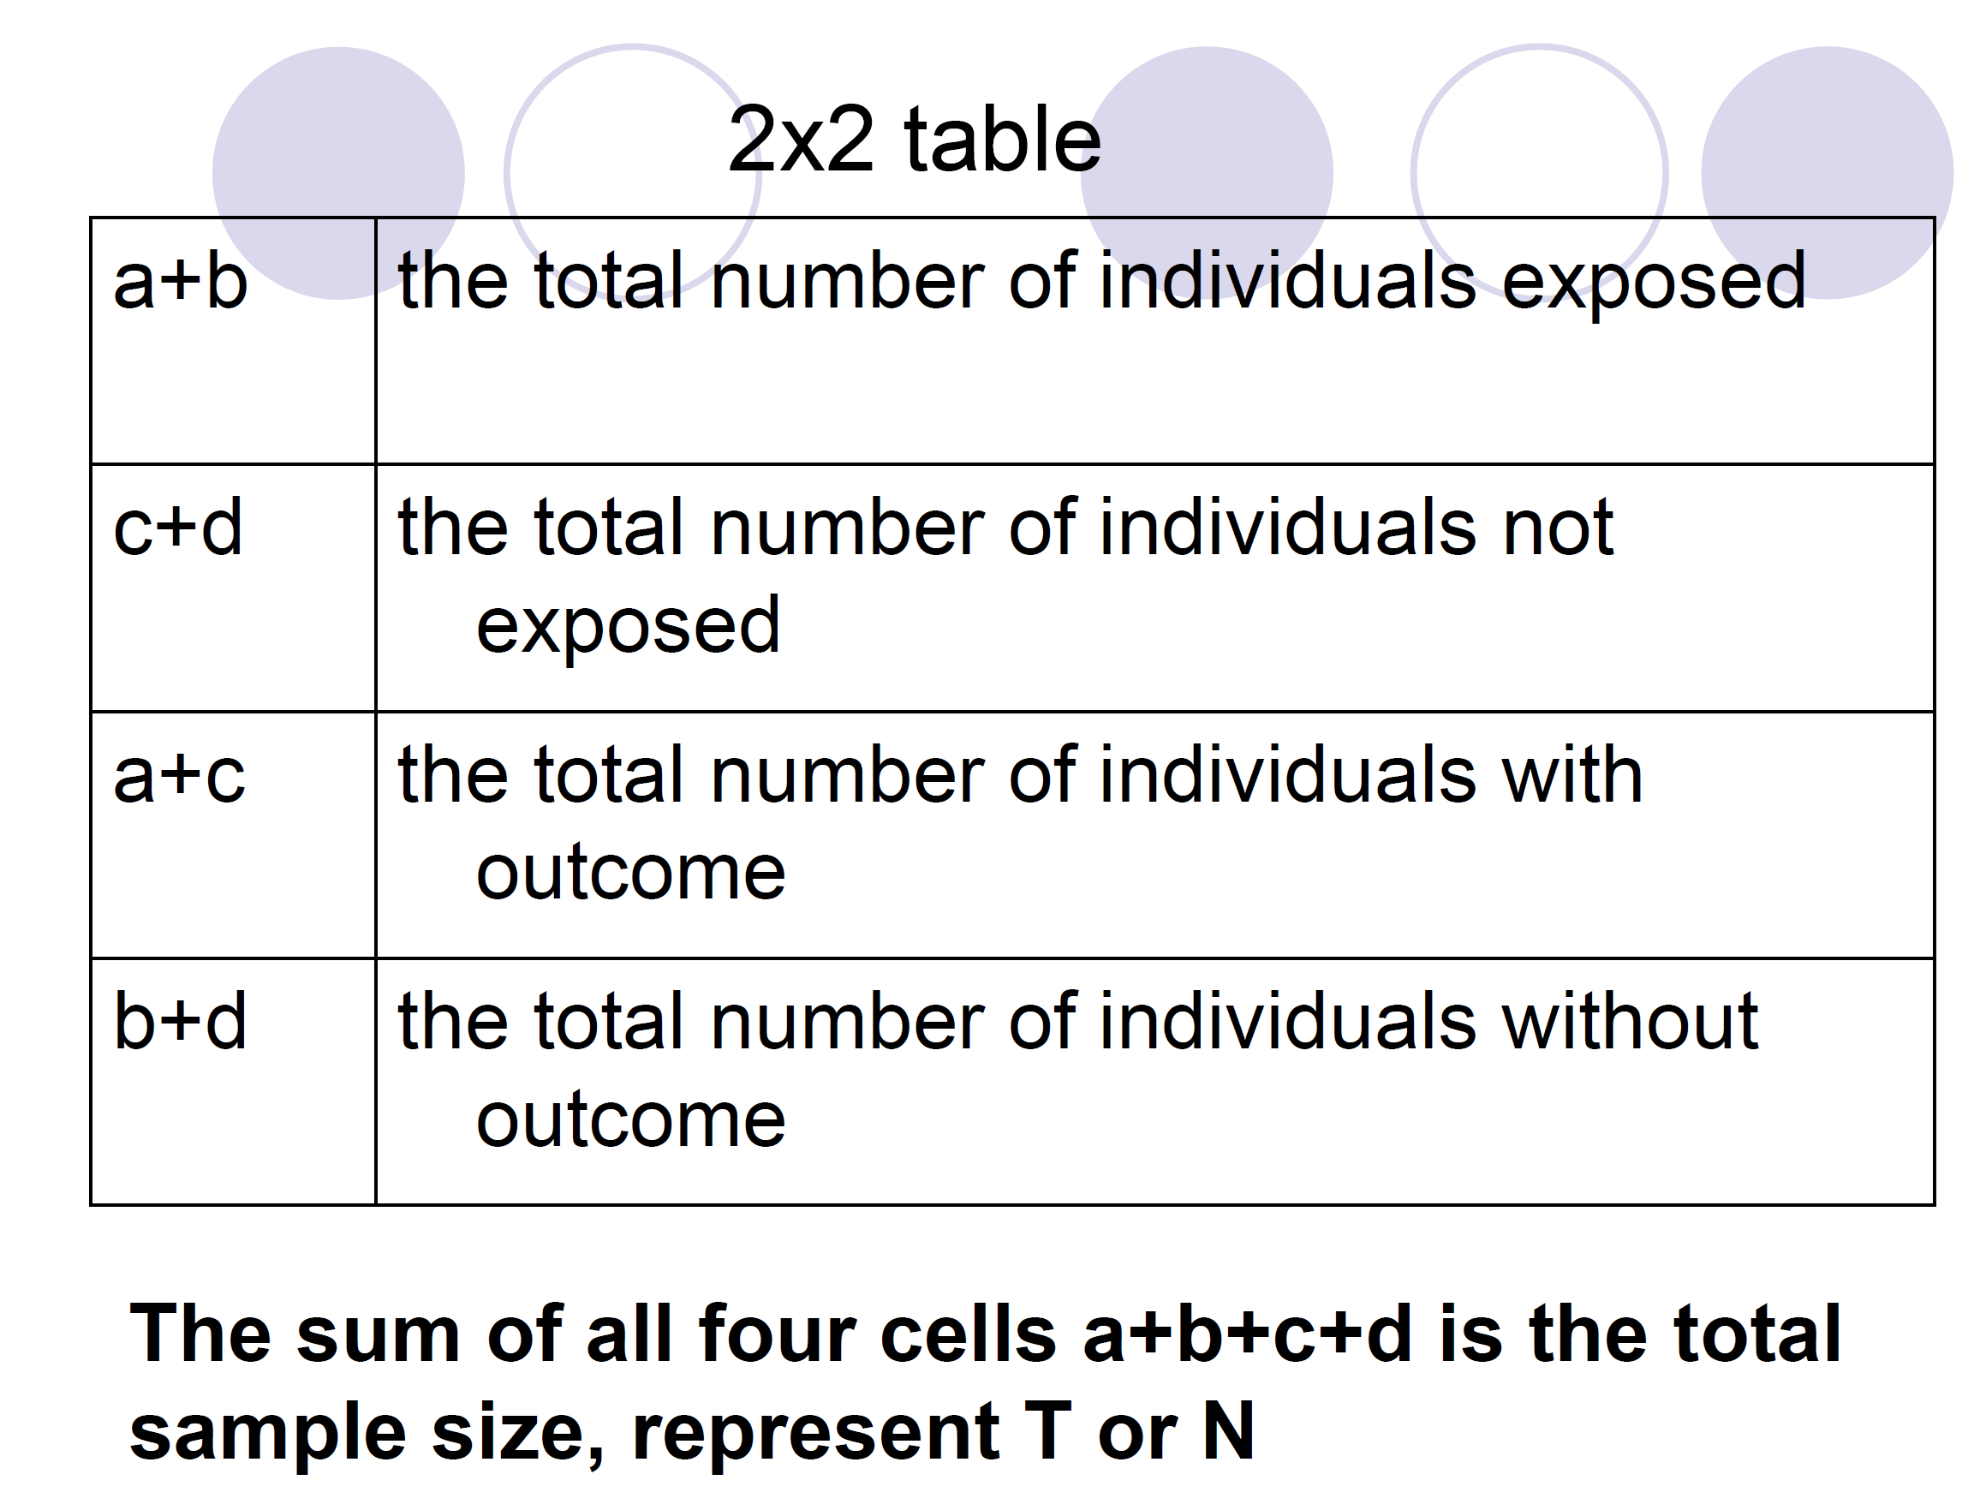

Slide 6
Measures of Association
Quantifies the relationship between exposure and outcome among two groups
ODDS Ratio
Risk Ratio
Ratio - how much more one group is to develop a disease than the another

Slide 7
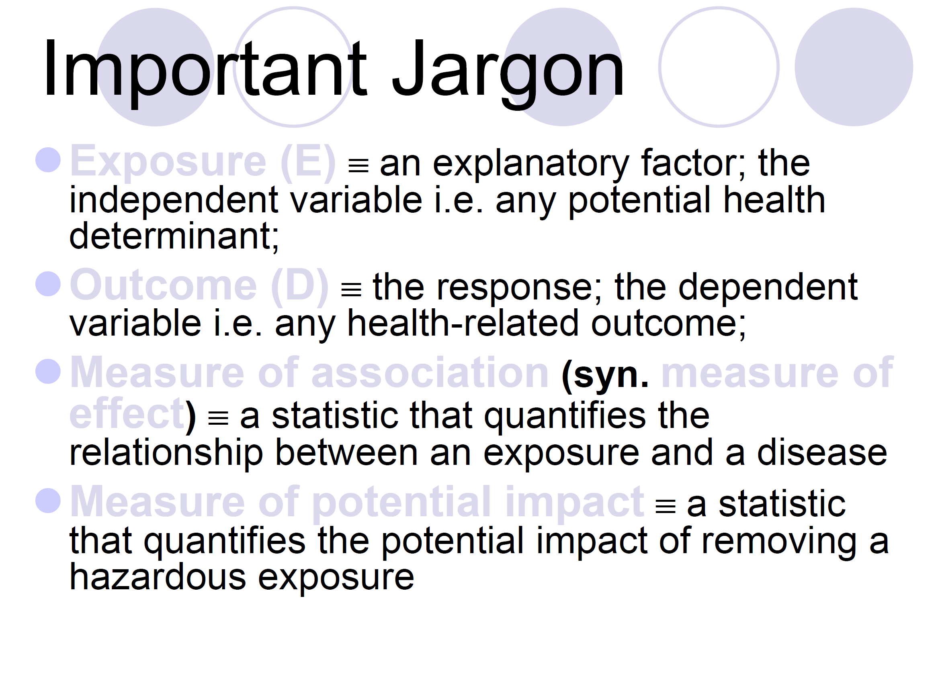

Slide 8
Relative Risk/Risk Ratio
Relative Risk/Risk Ratio (RR) →relative effect associated with exposure or the “risk”
Cohort studies
“Risk” refers to the probability of occurrence of an event or outcome

Slide 9
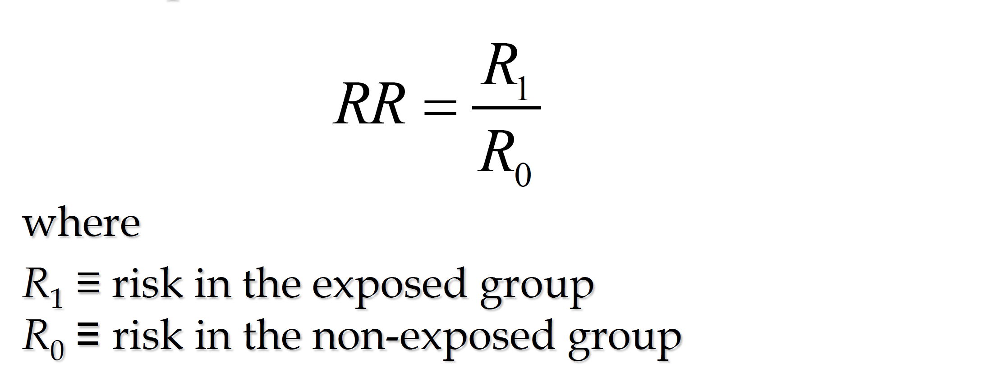
Risk Ratio

Slide 10
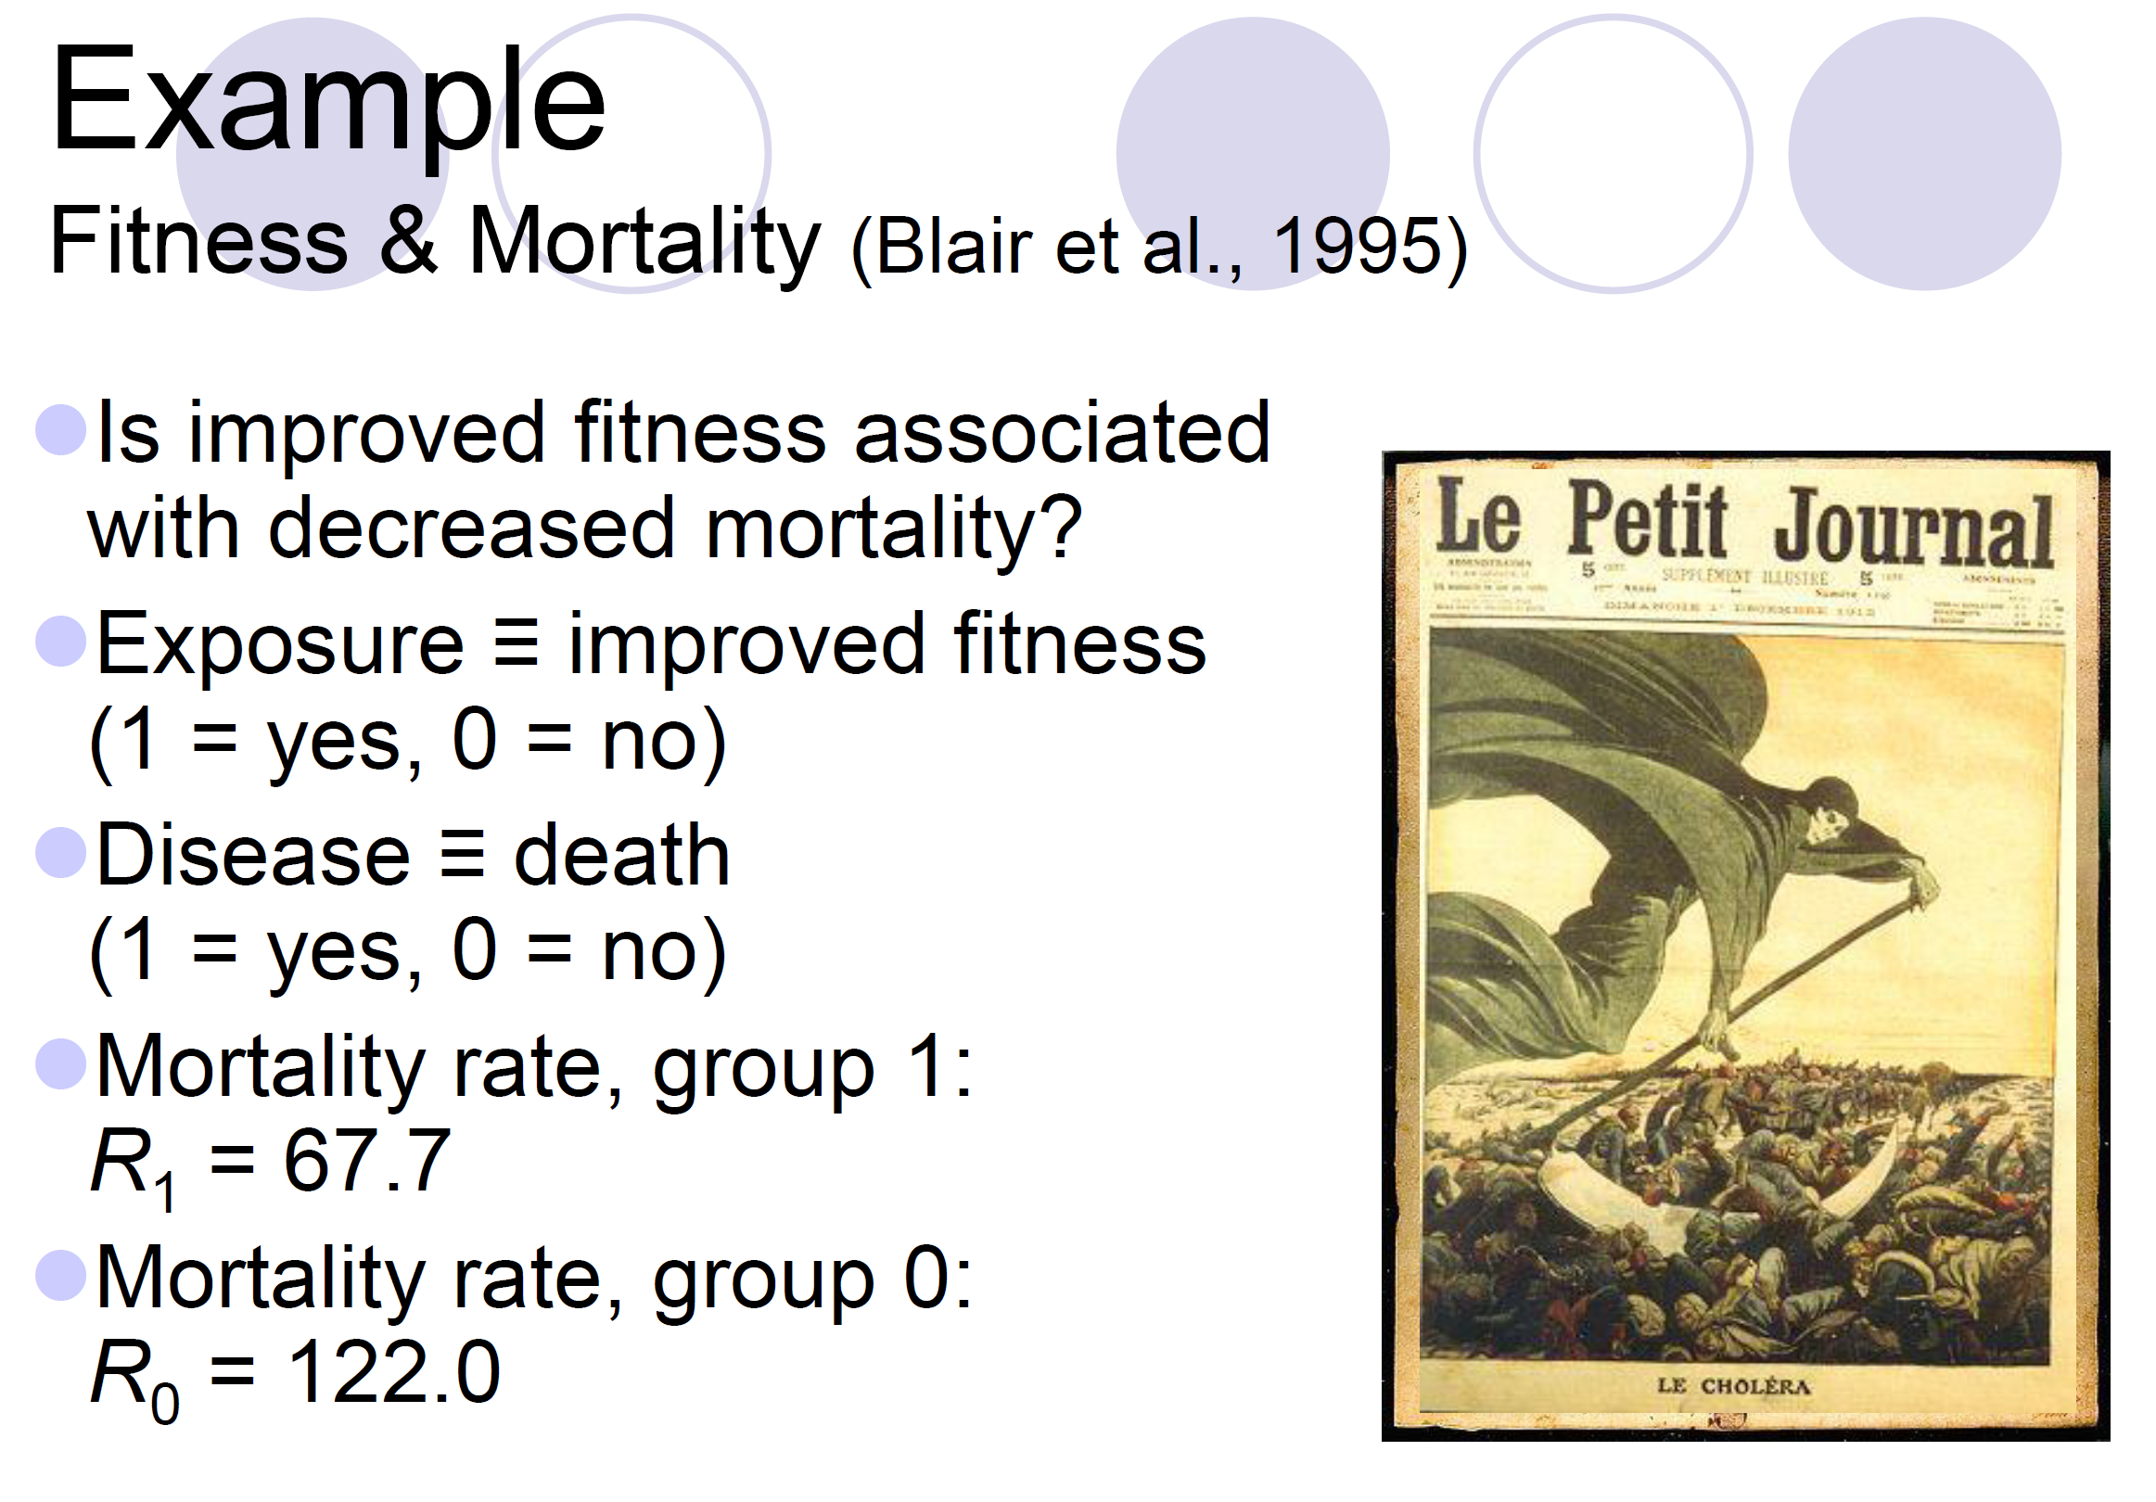

Slide 11
RR?

Slide 12
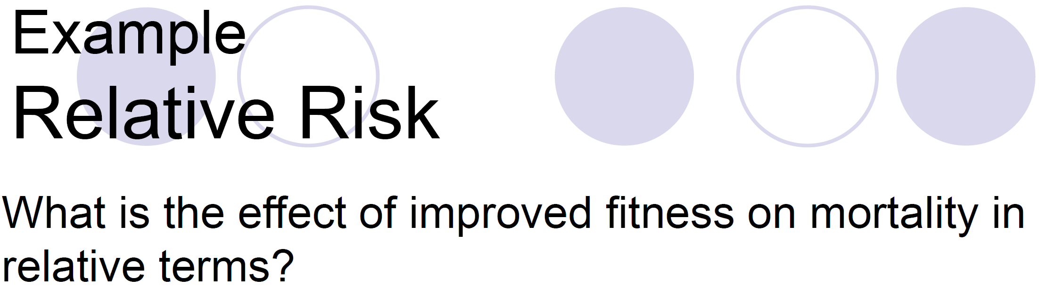
The effect of the exposure is to cut the risk almost in half.

Slide 13
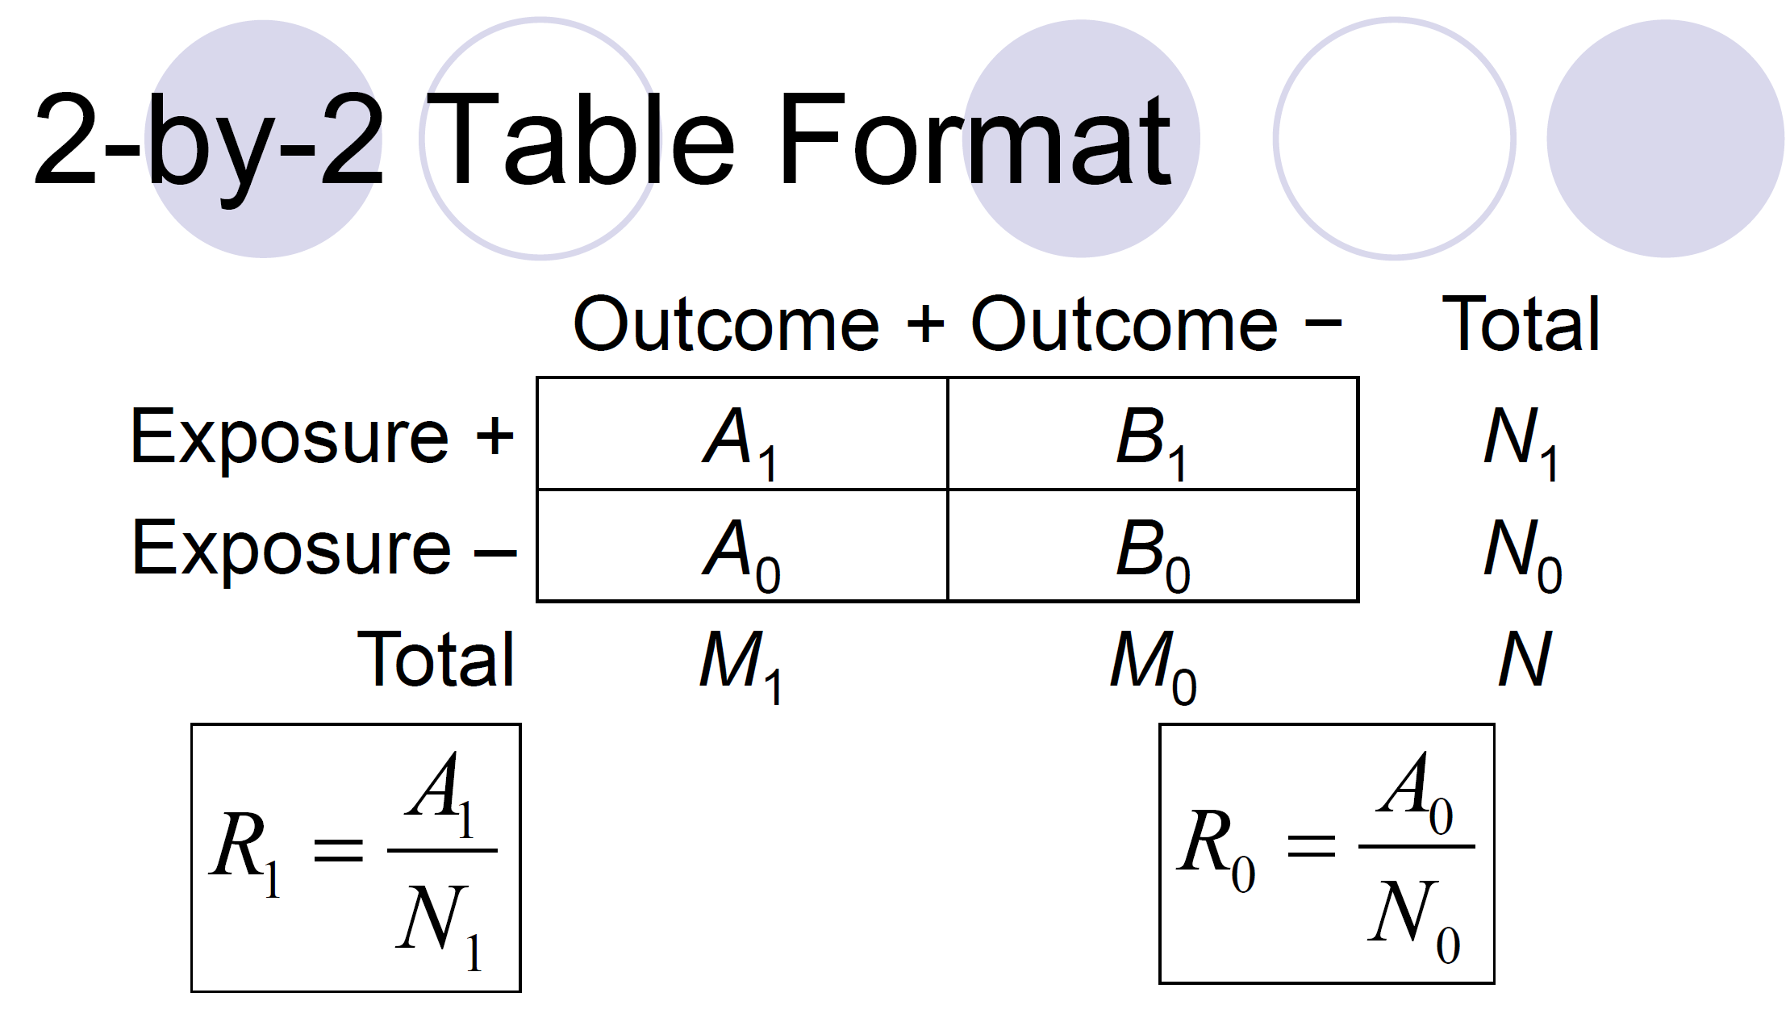

Slide 14
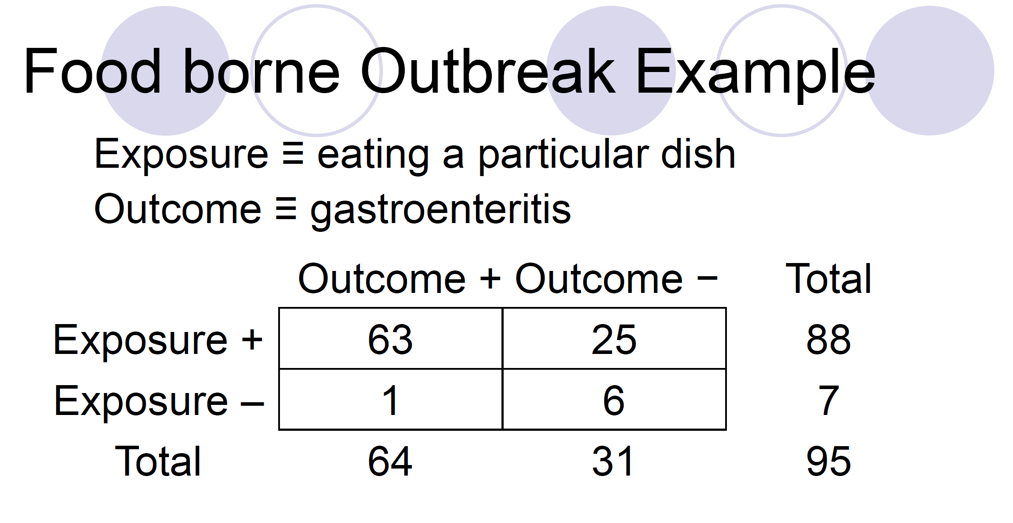

Slide 15
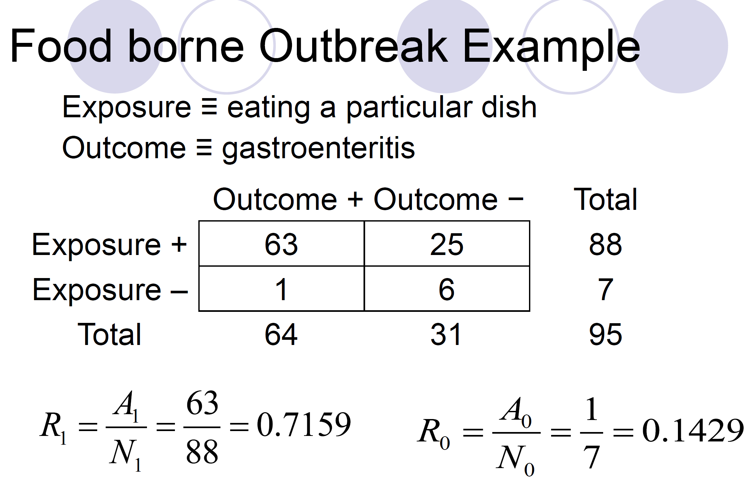

Slide 16
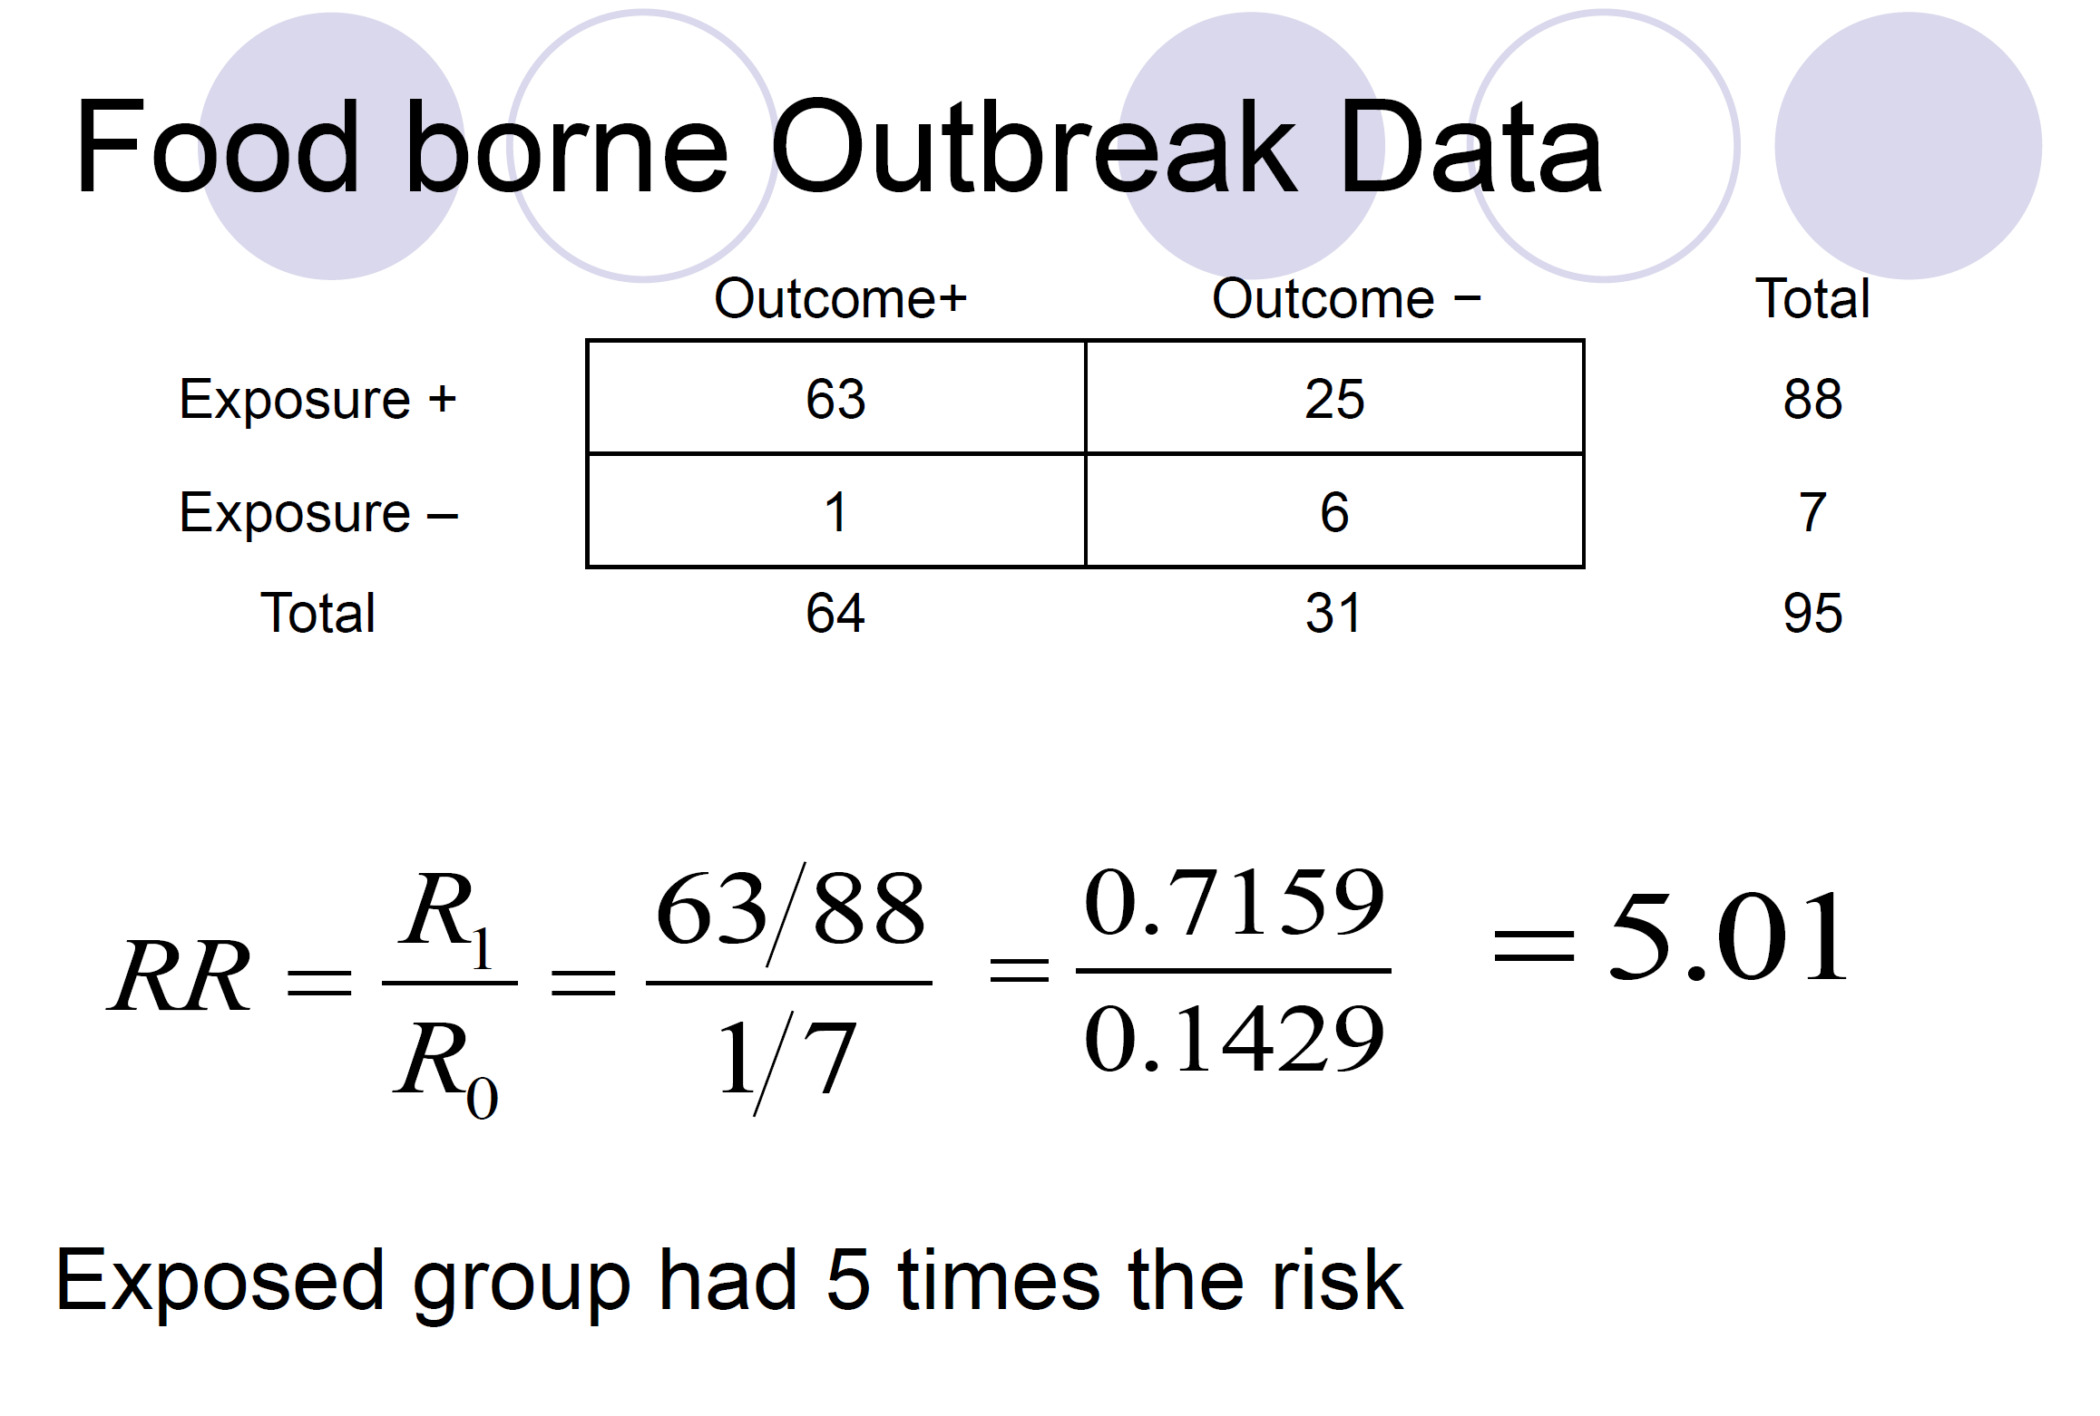

Slide 17
How to report RR
The risk of food borne disease is 5X higher in the exposed group compared to the non exposed group.
Exposure is associated with 400% increase in the risk of food borne disease.
Note:: Remember to report the 95% Confidence interval for each
Notes:
→ why not 500% because risk means for every case of foodborne disease there is a case without foodborne diease. There are 4 extra cases for every non-case.

Slide 18
ODD Ratio
An odds ratio (OR) → is a measure of association between an exposure and an outcome.
“Odds” refers to the probability of occurrence of an event/probability of the event not occurring.¹
The OR represents the odds that an outcome will occur given a particular exposure, compared to the odds of the outcome occurring in the absence of that exposure.
Case control studies

Slide 19
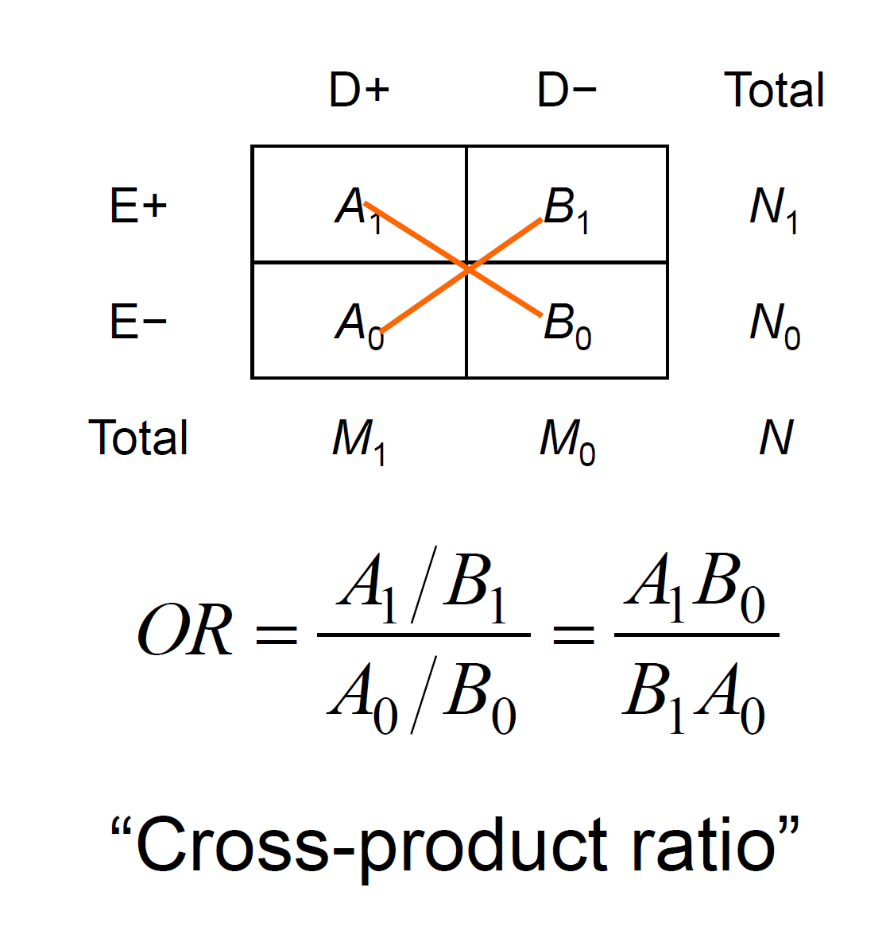

Slide 20
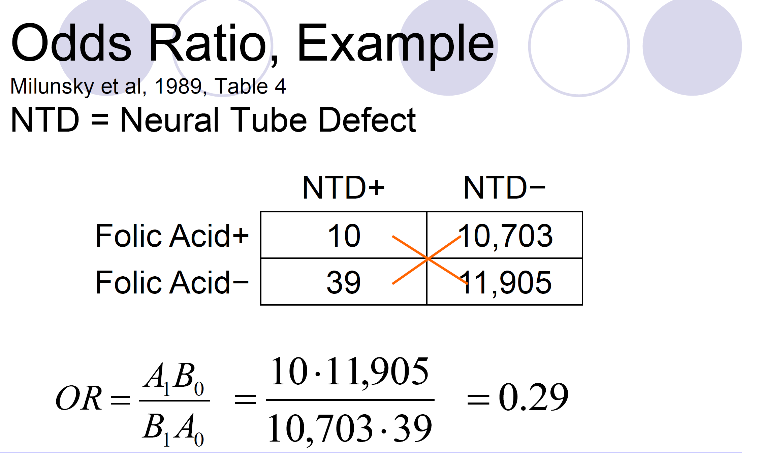

Slide 21
How to report OR
The odds of neural tube effect (outcome) given folic acid consumption (exposure) is 0.29X lower relative to lack of folic acid.
The odds of neural tube effect (outcome) given folic acid consumption (exposure) is 71% lower relative to lack of folic acid.
Note:: Remember to report the 95% Confidence interval for each

Slide 22
Risk Ratio vs Odds Ratio
In case-control studies, and in cohort studies in which the outcome occurs in less than 10% of the unexposed population, the OR provides a reasonable approximation of the RR
RR represent the risk of an outcome among the exposed group compared to the risk of the outcome in the non exposed group
OR represents the odds that an outcome will occur given a particular exposure, compared to the odds of the outcome occurring in the absence of that exposure.

Slide 23
What if?
Want to deal with confounding

Slide 24
What if?
Want to deal with confounding during analysis
Regression (only works if you can identify and measure the confounders)
Stratify
adjustment (usually distorted by choice of standard)

Slide 25
Logistic regression
Logistic regression - a regression modelling technique for producing Odds Ratios (ORs); models the log odds of a binary “outcome”
Effect of T.B infection on death in HIV positive patients crude(unadjusted) OR; 95% CI and hypothesis tests
Effect of mothers education on childs’ measles immunisation status
Effect of ethnicity on risk of death from breast cancer
Effect of gender on being a high wage earner

Slide 26
Why model log odds?
The reason for modelling the log odds rather than risk or odds is that the log odds can take any value, positive or negative, whereas risks are constrained to lie between 0 and 1.
When using statistical models it is easier to model a quantity which is unconstrained than one which is constrained.
This avoids the possibility of predicting impossible values (like risks which are negative or greater than 1) from the model.
Modelling log odds is referred to as logistic regression, and the models arereferred to as logistic models.

Slide 27
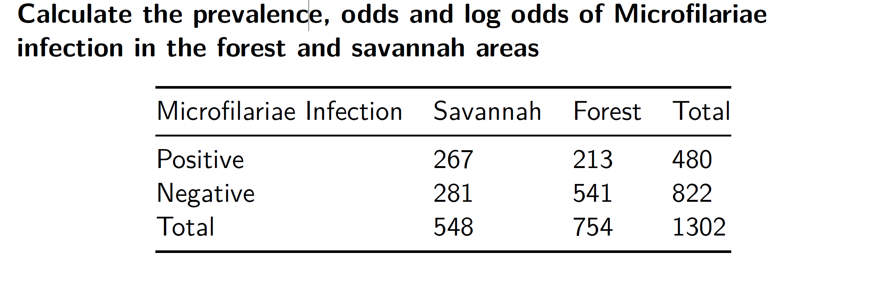
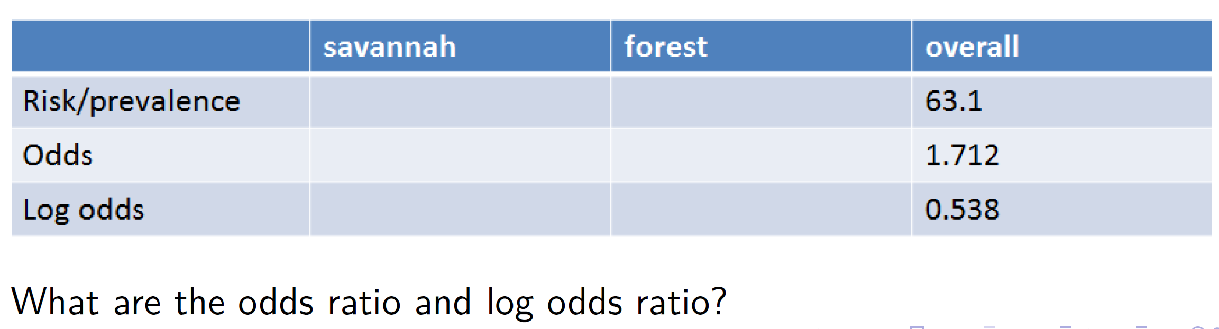
Example

Slide 28
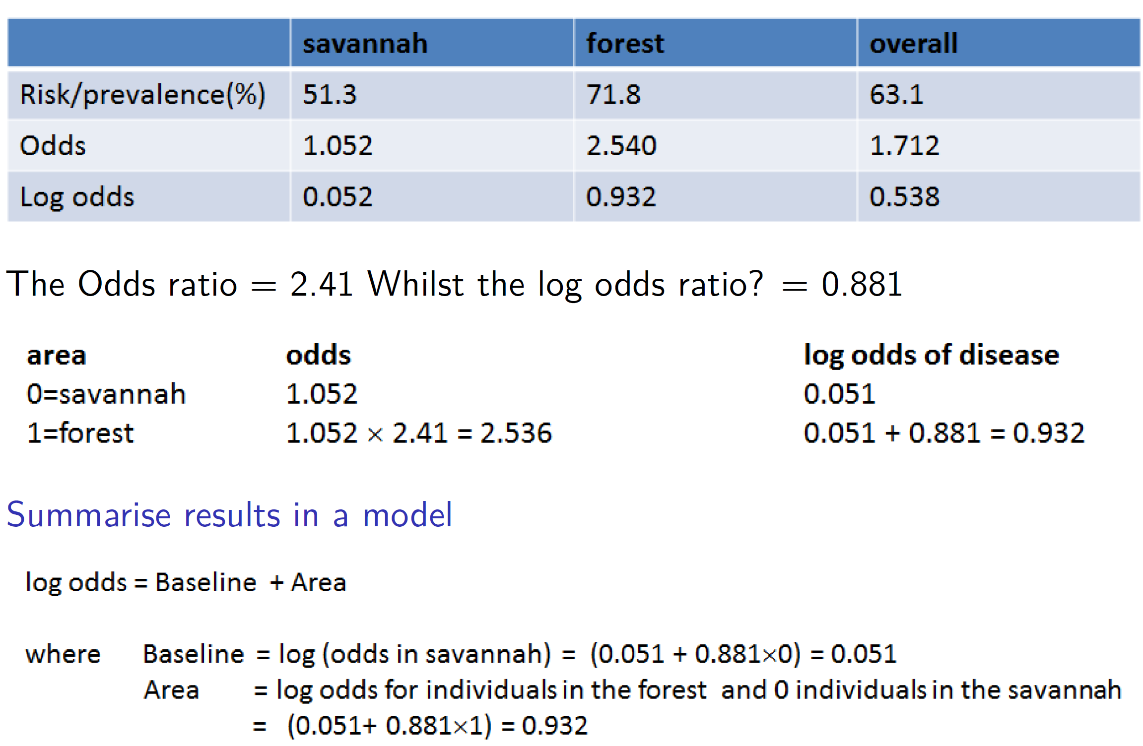

Slide 29
Example in R - https://bit.ly/2OTXImY
Calculate the prevalence, odds and log odds of Microfilariae infection in the forest and savannah areas
onch <-read.csv("onchall.csv") # Read in CSV data
m1 <- glm(mf~area, data=onch,family=binomial)# Run model
summary(m1)

